Slide 1


Stock Price Prediction using LSTM and News Sentiment Analysis
Divyam Gupta
Rishabh Tiwari
Rohan Bhardwaj
Mentor: Dr. Swati Srivastava

Slide 2
Objective
To predict the closing price of a company based on its previous stock movement and recent news
Creating a Website for the end user to interact with our model
To determine the future value of a company stock or other financial instruments traded on an exchange

Slide 3
Technology
Machine Learning
To build an algorithm for training and prediction.
LSTM
Popular algorithm for time-series forecasting
HTML and CSS
For developing a frontend for user to interact
Django
For connecting the UI with the ML backend

Slide 4
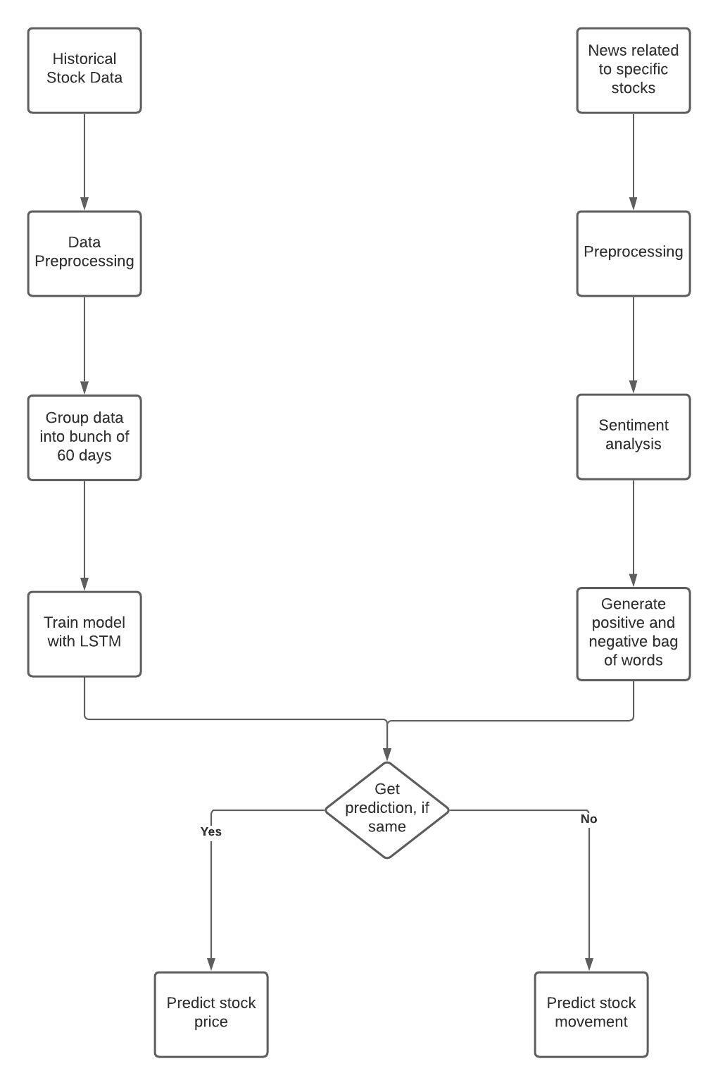
Proposed Model

Slide 5
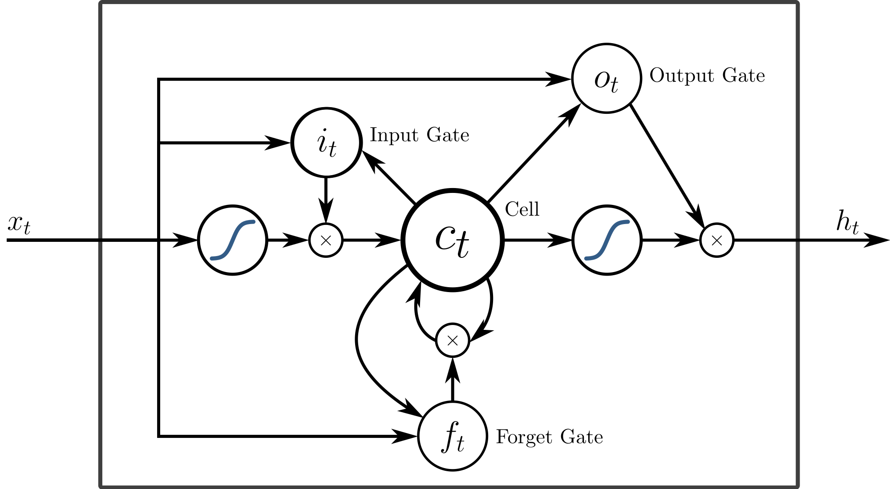
Long Short Term Memory
LSTMs are very powerful in sequence prediction problems because they're able to store past information.
A form of RNN
The same network is trained through sequence of inputs across “time”
Has Feedback Connection
Fixes the vanishing gradient problem of RNN

Slide 6
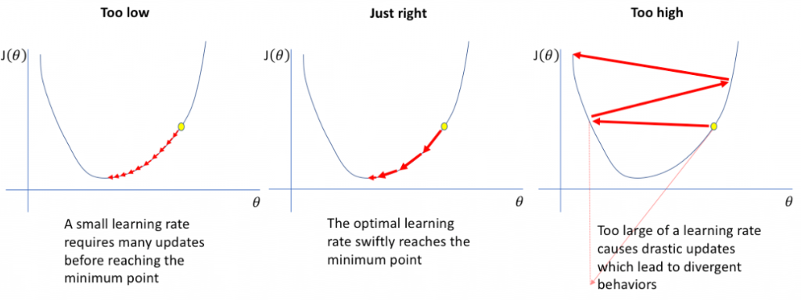
Gradient Problem

Slide 7
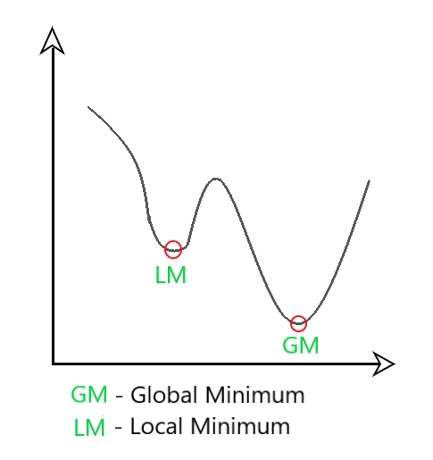
Adam Optimizer
Adaptive Moment Estimation is an algorithm for optimization technique for gradient descent
Adam combines the best properties of the AdaGrad and RMSProp algorithms to provide an optimization algorithm that can handle sparse gradients on noisy problems.
We control the rate of gradient descent in such a way that there is minimum oscillation when it reaches the global minimum while taking big enough steps (step-size) so as to pass the local minima hurdles along the way

Slide 8
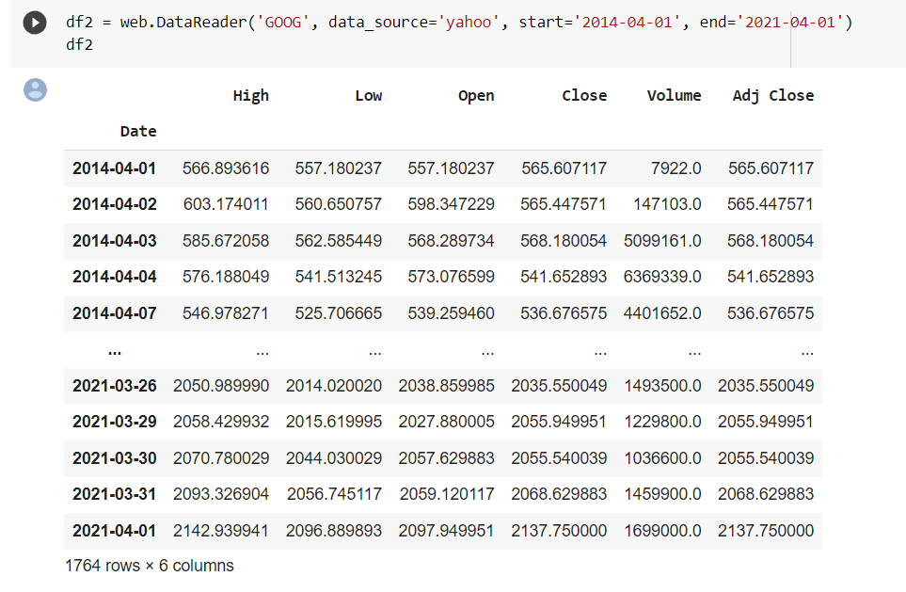
Numeric Dataset

Slide 9
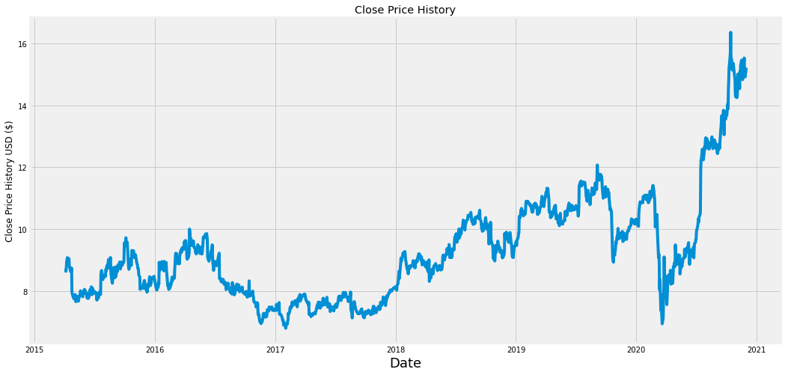
Graphical Representation Of DataSet

Slide 10
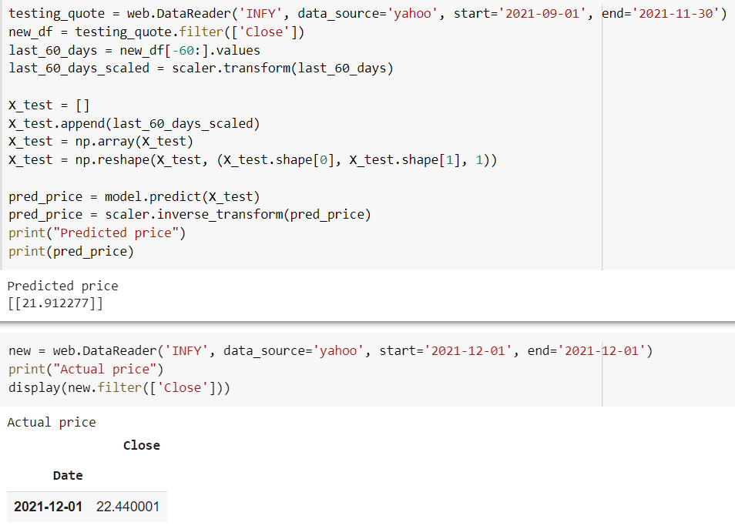
Model Testing On Infosys stocks

Slide 11
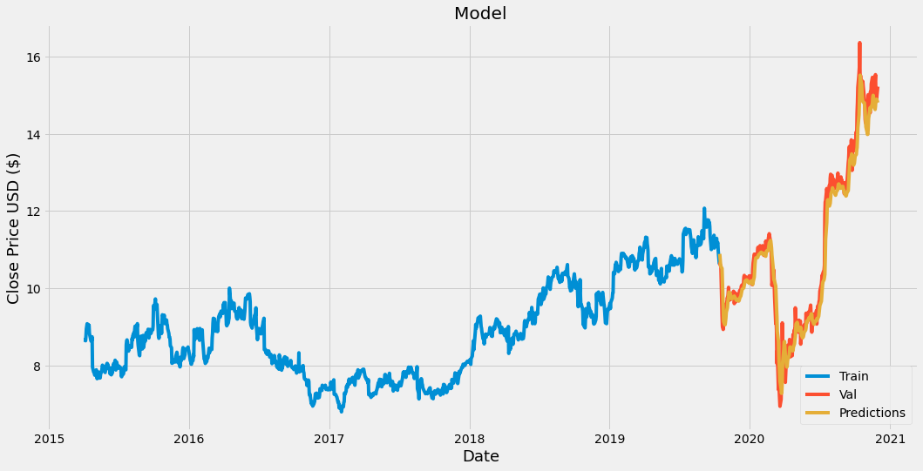
LSTM Prediction

Slide 12
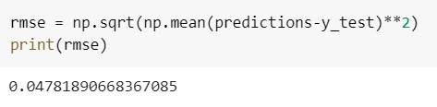
Mean Square Error (MSE)
The MSE of an estimator measures the squares of the errors.
The MSE is a measure of the quality of an estimator. It is a positive value that decreases as the error approaches zero.

Slide 13
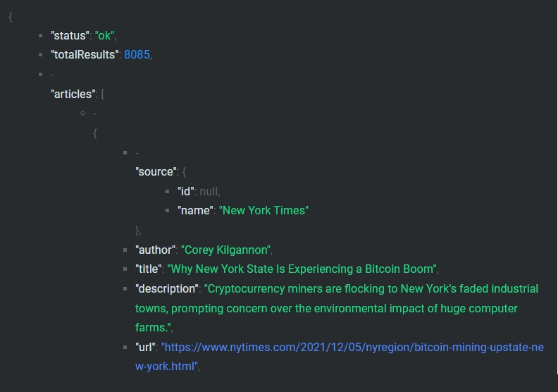
News dataset

Slide 14
Applications
To predict the stock prices of a company
Analysing the risk in the market
Getting to know the market mood

Slide 15
Thank YOU ☺

